Slide 1
Optimal Power Flow in Distribution Systems
EE 653 Power distribution system modeling, optimization and simulation
GRA: Qianzhi Zhang
Advisor: Dr. Zhaoyu Wang
Department of Electrical and Computer Engineering
Iowa State University

Slide 2
Outline
How to formulate optimal power flow for distribution systems
Objectives
Single objective
Multi-objectives
Constraints
Equality constraints
Inequality constraints
Variables
Continuous variables
Discrete variables
How to solve optimal power flow for distribution systems
How to deal with the non-convex OPF
Approximation and relaxation
Conventional solution methods
LP, NLP, MILP and MINLP in GAMS
Distributed solution methods
ADMM
Heuristic methods
GA, PSO

Slide 3
How to formulate OPF
The optimal power flow (OPF) was introduced by Carpentier in 1962 [1].
Generally, the OPF is a nonlinear and non-convex problem including an objective function which must be optimized (maximized or minimized), a set of equality and inequality constraints which must be satisfied (without violating power flow constraints and operational limits), and a problem-solving method [2].
$$minimize or maximize{f(x,u)}$$
subject to
$$g\left(x,u\right)=0$$
$$h\left(x,u\right)≤0$$
$LB≤x$ $≤UB$
[1] Carpentier, J. "Contribution a l’etude du dispatching economique." Bulletin de la Societe Francaise des Electriciens3.1 (1962): 431-447.
[2] Abdi, Hamdi, Soheil Derafshi Beigvand, and Massimo La Scala. "A review of optimal power flow studies applied to smart grids and microgrids." Renewable and Sustainable Energy Reviews 71 (2017): 742-766.

Slide 4
Objective functions
Objective functions
Voltage profiles management
Active power losses
Active power generation cost
Power supplied to the grid from an external utility (upstream grid)
Carbon emission
Load curtailment
Social welfare
…
Single objective
Multiple objectives
[2] Abdi, Hamdi, Soheil Derafshi Beigvand, and Massimo La Scala. "A review of optimal power flow studies applied to smart grids and microgrids." Renewable and Sustainable Energy Reviews 71 (2017): 742-766.

Slide 5
Constraints
Constraints introduce the feasible region of the OPF problem.
Equality constraints:
Power flow equations (active/reactive line flows, bus voltages)
$$P_{i+1}=P_{i}−p_{i+1}−r_{i}\frac{P_{i}^{2}+Q_{i}^{2}}{V_{i}^{2}}$$
$$Q_{i+1}=Q_{i}−q_{i+1}−x_{i}\frac{P_{i}^{2}+Q_{i}^{2}}{V_{i}^{2}}$$
$V_{i+1}^{2}=V_{i}^{2}−$2$\left(r_{i}P_{i}+x_{i}Q_{i}\right)+\left(r_{i}^{2}+x_{i}^{2}\right)\frac{P_{i}^{2}+Q_{i}^{2}}{V_{i}^{2}}$
[2] Abdi, Hamdi, Soheil Derafshi Beigvand, and Massimo La Scala. "A review of optimal power flow studies applied to smart grids and microgrids." Renewable and Sustainable Energy Reviews 71 (2017): 742-766.

Slide 6
Constraints
Inequality constraints:
Active power constraints
Reactive power constraints
Bus voltage constraints (magnitudes and angles)
Line current/flow constraints
Load curtailment (demand response)
Limits on switching mechanical equipment
Capacitor banks
Tap position constraints
…
Various operational constraints associated with devices:
Battery
Fuel cell
The purchased and sold powers
PV shedding
…
[2] Abdi, Hamdi, Soheil Derafshi Beigvand, and Massimo La Scala. "A review of optimal power flow studies applied to smart grids and microgrids." Renewable and Sustainable Energy Reviews 71 (2017): 742-766.

Slide 7
Variables
Variables in OPF:
Continuous variables
Distributed generators
Inverters that connects distributed generators to the grid
Controllable loads (cooling and heating systems, electricity vehicles)
Smart appliances
…
Discrete variables
Capacitors bank (binary variables)
On load tap changers (integer variables)
…
For example,
In Volt/VAR optimization, reactive power injection of the inverters and voltage regulators are controlled to regulate the voltages.
In demand response, real power consumption of controllable loads are reduced or shifted in response to power supply conditions.
[2] Abdi, Hamdi, Soheil Derafshi Beigvand, and Massimo La Scala. "A review of optimal power flow studies applied to smart grids and microgrids." Renewable and Sustainable Energy Reviews 71 (2017): 742-766.

Slide 8
Optimal Power flow for radial distribution system
Based on different forms:
Steady state OPF
Transient stability-constrained OPF (transient voltage constraints, transient frequency constraints and transient rotor angle constraints)
Security-constrained OPF (N-1 contingency, reserve constraints)
Stochastic OPF (load/DER uncertainties)
AC OPF
DC OPF
…
Based on different applications:
Optimal power management
Volt/VAR optimization
Demand response
Stability and reliability assessment
…
[2] Abdi, Hamdi, Soheil Derafshi Beigvand, and Massimo La Scala. "A review of optimal power flow studies applied to smart grids and microgrids." Renewable and Sustainable Energy Reviews 71 (2017): 742-766.

Slide 9
How to solve OPF
The OPF problem is difficult to solve due to the nonconvex power flow physical laws. There are in general three ways to deal with this challenge:
Approximation: linearizing the power flow formulations
Relaxation: semidefinite programming (SDP) or second-order cone program (SCOP)
In the “power flow calculation” class, we have covered some approaches to linearize the power flow:
DCOPF
Completely ignore reactive power, assume all the voltage are always 1 p.u., ignore line conductance
May not satisfy the nonlinear power flow equations
Can be used as initial point for other methods, but cannot provide final solutions in distribution systems
Dist-flow
Neglect nonlinear terms (Linearized Dist-flow)
Piecewise linear formulation (may be more accurate)
[3] Gan, Lingwen, et al. "Optimal power flow in tree networks." 52nd IEEE Conference on Decision and Control. IEEE, 2013.

Slide 10
SDP Relaxation of OPF
The NLP-based OPF has the convergence problem due to its nonconvex nature [4].
The semidefinite programming (SDP) has been one of the most active fields in numerical optimization for over decades.
It has been proven that the SDP is convex and the primal-dual interior point algorithm for SDP may possess super-linear convergence theoretically.
The SDP belongs to convex optimization and can guarantee global optimal solution using interior point method (IPM).
In general, to reformulate a classical OPF to a SDP model:
By applying $X=x^{T}x$, where $x$ is a row vector.
The nonconvex quadratic terms of power flow constraints will be replaced with the relevant elements of the variable matrix $X$ in SDP.
The SDP is concerned with choosing a positive semidefinite matrix to optimize a linear function which is subject to linear constraint. In other words, the LP is generalized by replacing the vector of variables with a symmetric matrix and the nonconvex constraints with a positive semidefinite constraint.
[4] Bai, Xiaoqing, et al. "Semidefinite programming for optimal power flow problems." International Journal of Electrical Power & Energy Systems 30.6-7: 383-392, 2008.

Slide 11
SDP Relaxation of OPF
Ref. [5] proposes a SDP relaxation of the ACOPF problem, which shows that the proposed SDP relaxed ACOPF can be solved by a generic optimization solver.
At each multiphase bus, the distribution network model can have:
Grounded wye-connected loads or resources.
Ungrounded delta-connected loads or resources.
A combination of wye- and delta-connected loads or resources at the primary side of distribution transformers.
A combination of line-to-line and line-to-grounded-neutral loads or resources at the secondary side of distribution transformers.
In [5], it assumes every bus have:
Three wye-connected net loads (one on each phase, with grounded neutral).
Three delta-connected net loads (one across each pair of phases, ungrounded).
[5] Zhao, Changhong, Emiliano Dall’Anese, and Steven H. Low. "Convex relaxation of OPF in multiphase radial networks with delta connection." Proc. of Bulk Power Systems Dynamics and Control Symposium. 2017.

Slide 12
SDP Relaxation of OPF
Let $V_{i}^{φ}$ denote the complex voltage on phase $φ$ of bus $i$, and define $V_{i}≔{\left[V_{i}^{a},V_{i}^{b}{,V}_{i}^{c}\right]}^{T}$.
Let $I_{ij}^{φ}$ denote the phase $φ$ current on the line from bus $i$ to bus $j$, and define $I_{ij}≔{\left[I_{ij}^{a},I_{ij}^{b}{,I}_{ij}^{c}\right]}^{T}$.
Let $y_{i}∈ℂ^{3×3}$ denote the shunt admittance at bus $i$ and $z_{ij}∈ℂ^{3×3}$ denote the series impedance of line $ij$.
Let $S_{Y,i}={\left[s_{Y,i}^{a},s_{Y,i}^{b},s_{Y,i}^{c}\right]}^{T}$denote the complex power consumptions of wye-connected net loads at bus $i$.
Let $S_{∆,i}={\left[s_{∆,i}^{ab},s_{∆,i}^{bc},s_{∆,i}^{ca}\right]}^{T}$and $I_{∆,i}={\left[I_{∆,i}^{ab},I_{∆,i}^{bc},I_{∆,i}^{ca}\right]}^{T}$denote the complex power consumptions and current of delta-connected net loads at bus $i$, respectively.
[5] Zhao, Changhong, Emiliano Dall’Anese, and Steven H. Low. "Convex relaxation of OPF in multiphase radial networks with delta connection." Proc. of Bulk Power Systems Dynamics and Control Symposium. 2017.

Slide 13
SDP Relaxation of OPF
Optimal power flow of extended branch flow model (OPF-EBEF):
The objective minimizes the operating cost.
The optimization variables ($s_{Y}$, $s_{∆}$) integrate both controllable and uncontrollable components of wye and delta-connected net loads.
$\left(s_{Y,i}\text{, }s_{∆,i}\right)∈S_{i}, ∀i∈𝒩$. We can specify
the operational constraints on the controllable net loads;
the values of the uncontrollable net loads;
the case where is no load or generation units at a certain bus/phase.
Min f($s_{Y}$, $s_{∆}$)
[5] Zhao, Changhong, Emiliano Dall’Anese, and Steven H. Low. "Convex relaxation of OPF in multiphase radial networks with delta connection." Proc. of Bulk Power Systems Dynamics and Control Symposium. 2017.

Slide 14
SDP Relaxation of OPF
s.t.
Definition of auxiliary variable:
$$ℓ_{ij},S_{ij},X_{i}∈ℂ^{3×3}$$
The $diag\left(ℓ_{ij}\right)$ denotes the magnitude squares of three phases of current $I_{ij}$.
The $diag\left(S_{ij}\right)$ denotes the sending-end three-phase power flow on line $i→j$.
H is the complex conjugate transpose operator
$$ℓ_{ij}=I_{ij}I_{ij}^{H}$$
$S_{ij}=V_{i}I_{ij}^{H}$, $∀i→j$
$X_{i}=V_{i}I_{i}^{H}$, $∀i∈𝒩$
$$s_{∆,i}=\left[\begin{matrix}\left(V_{i}^{a}−V_{i}^{b}\right){\left(I_{∆,i}^{ab}\right)}^{∗} \\ \left(V_{i}^{b}−V_{i}^{c}\right){\left(I_{∆,i}^{bc}\right)}^{∗} \\ \left(V_{i}^{c}−V_{i}^{a}\right){\left(I_{∆,i}^{ca}\right)}^{∗}\end{matrix}\right]$$
$$=diag\left(ΓV_{i}I_{∆,i}^{H}\right)=diag\left(ΓX_{i}\right)$$
Three-phase delta-connected load at bus $i$
$$Γ=\left[\begin{matrix}1 & −1 & 0 \\ 0 & 1 & −1 \\ −1 & 0 & 1\end{matrix}\right]$$
[5] Zhao, Changhong, Emiliano Dall’Anese, and Steven H. Low. "Convex relaxation of OPF in multiphase radial networks with delta connection." Proc. of Bulk Power Systems Dynamics and Control Symposium. 2017.

Slide 15
SDP Relaxation of OPF
Power balance constraints
The receiving-end three-phase power flow on line $k→i$ as:
The three-phase power flow to the shunt element at bus $i$:
$$\sum_{k:k→i}{diag(S_{ki}−z_{ki}ℓ_{ki})}−\sum_{k:k→i}{diag\left(S_{ij}\right)}$$
$=$ $diag\left(V_{i}V_{i}^{H}y_{i}^{H}\right)+s_{Y,i}+$ $diag(ΓX_{i})$ , $∀i∈𝒩$
$diag(V_{i}I_{ki}^{H})$ $=diag\left(V_{k}I_{ki}^{H}−\left(V_{k}−V_{i}\right)I_{ki}^{H}\right)$
$$=diag(S_{ki}−z_{ki}ℓ_{ki})$$
$$diag(V_{i}V_{i}^{H}y_{i}^{H})$$
$$V_{i}−V_{j}=z_{ij}I_{ij}$$
$$V_{0}=V_{0}^{ref}$$
The substation voltage is fixed and given as $V_{0}^{ref}$.
All the other buses enforces the voltage magnitudes.
$$\underline{V_{i}^{φ}}≤ \left|V_{i}^{φ}\right|≤\overline{V_{i}^{φ}}$$
[5] Zhao, Changhong, Emiliano Dall’Anese, and Steven H. Low. "Convex relaxation of OPF in multiphase radial networks with delta connection." Proc. of Bulk Power Systems Dynamics and Control Symposium. 2017.

Slide 16
SDP Relaxation of OPF
In [5], it is assumed that $f$ in the objective is a convex function.
Sets $S_{i}$ are convex and compact for a number of controllable loads.
The OPF problem is nonconvex only because of the quadratic equality constraints:
$$ℓ_{ij}=I_{ij}I_{ij}^{H}$$
$$\sum_{k:k→i}{diag(S_{ki}−z_{ki}ℓ_{ki})}−\sum_{k:k→i}{diag\left(S_{ij}\right)}$$
= $diag(V_{i}V_{i}^{H}y_{i}^{H})$+$s_{Y,i}$+ $diag(ΓX_{i})$ , $∀i∈𝒩$
$X_{i}=V_{i}I_{i}^{H}$, $∀i∈𝒩$
$S_{ij}=V_{i}I_{ij}^{H}$, $∀i→j$
This paper introduces method to obtain the convex surrogate of the original OPF via SDP relaxation.
[5] Zhao, Changhong, Emiliano Dall’Anese, and Steven H. Low. "Convex relaxation of OPF in multiphase radial networks with delta connection." Proc. of Bulk Power Systems Dynamics and Control Symposium. 2017.

Slide 17
SDP Relaxation of OPF
It first reformulates the original OPF as the following equivalent problem, with some newly defined parameters:
Min f($s_{Y}$, $s_{∆}$)
s.t.
$$\sum_{k:k→i}{diag(S_{ki}−z_{ki}ℓ_{ki})}−\sum_{k:k→i}{diag\left(S_{ij}\right)}$$
$=$ $diag(v_{i}y_{i}^{H})$ $+ s_{Y,i}$ $+$ $diag(ΓX_{i})$ , $∀i∈𝒩$
Power balance constraints
Newly parameters $v_{i}=V_{i}V_{i}^{H}$
$$v_{j}=v_{i}−\left(S_{ij}z_{ij}^{H}+z_{ij}S_{ij}^{H}\right)+z_{ij}ℓ_{ij}z_{ij}^{H}$$
$$v_{0}=V_{0}^{ref}{\left(V_{0}^{ref}\right)}^{H}$$
Bus voltage constraints
$$\underline{v_{i}}≤diag\left(v_{i}\right)≤\overline{v_{i}}$$
[5] Zhao, Changhong, Emiliano Dall’Anese, and Steven H. Low. "Convex relaxation of OPF in multiphase radial networks with delta connection." Proc. of Bulk Power Systems Dynamics and Control Symposium. 2017.

Slide 18
SDP Relaxation of OPF
The OPF is nonconvex only because of the following quadratic constraints and the voltage-related constraint $\underline{V_{i}^{φ}}≤ \left|V_{i}^{φ}\right|≤\overline{V_{i}^{φ}}$
$$ℓ_{ij}=I_{ij}I_{ij}^{H}$$
$$\sum_{k:k→i}{diag(S_{ki}−z_{ki}ℓ_{ki})}−\sum_{k:k→i}{diag\left(S_{ij}\right)}$$
= $diag(V_{i}V_{i}^{H}y_{i}^{H})$+$s_{Y,i}$+ $diag(ΓX_{i})$ , $∀i∈𝒩$
$X_{i}=V_{i}I_{i}^{H}$, $∀i∈𝒩$
$S_{ij}=V_{i}I_{ij}^{H}$, $∀i→j$
Positive semidefinite constraints $XX^{H}≥0$
$\left[\begin{matrix}V_{i} \\ I_{ij}\end{matrix}\right]{\left[\begin{matrix}V_{i} \\ I_{ij}\end{matrix}\right]}^{H}=\left[\begin{matrix}v_{i} & S_{ij} \\ S_{ij}^{H} & ℓ_{ij}\end{matrix}\right]$ $≽0\text{,} ∀i→j$
$\left[\begin{matrix}V_{i} \\ I_{∆,i}\end{matrix}\right]{\left[\begin{matrix}V_{i} \\ I_{∆,i}\end{matrix}\right]}^{H}=\left[\begin{matrix}v_{i} & X_{ij} \\ X_{ij}^{H} & ρ_{ij}\end{matrix}\right]$ $≽0\text{, }∀i∈𝒩$
$v_{i}≽0$, $∀i∈𝒩$
[5] Zhao, Changhong, Emiliano Dall’Anese, and Steven H. Low. "Convex relaxation of OPF in multiphase radial networks with delta connection." Proc. of Bulk Power Systems Dynamics and Control Symposium. 2017.

Slide 19
SDP Relaxation of OPF
$rank\left(v_{i}\right)=1$, $∀i∈𝒩$
Rank-1 constraints:
The rank of a matrix is an estimate of the number of linearly independent rows or columns of a matrix A.
The matrix has rank 1 because each of its column is a multiple of the first column.
Every rank 1 matrix $A$ can be written as $A=UV^{T}$, where $U$ and $V$ are column vector.
For example
$$A=\left[\begin{matrix}1 & 4 & 5 \\ 2 & 8 & 10\end{matrix}\right]$$
$$A=\left[\begin{matrix}1 \\ 2\end{matrix}\right]\left[\begin{matrix}1 & 4 & 5\end{matrix}\right]$$
$$rank\left(\left[\begin{matrix}v_{i} & S_{ij} \\ S_{ij}^{H} & ℓ_{ij}\end{matrix}\right]\right)=1\text{,} ∀i→j$$
$$rank\left(\left[\begin{matrix}v_{i} & X_{ij} \\ X_{ij}^{H} & ℓ_{ij}\end{matrix}\right]\right)=1\text{, }∀i∈𝒩$$
[5] Zhao, Changhong, Emiliano Dall’Anese, and Steven H. Low. "Convex relaxation of OPF in multiphase radial networks with delta connection." Proc. of Bulk Power Systems Dynamics and Control Symposium. 2017.

Slide 20
SDP Relaxation of OPF
The primal–dual interior point method (PDIPM) is used to solve the SDP problem successfully.
$$\min{A_{0}⨂X}$$
$$\min{A_{0}⨂X−μ\ln{(det⁡(X))}}$$
s.t.
s.t.
$$A_{i}⨂X=b_{i}$$
Relaxed barrier version
$$A_{i}⨂X=b_{i}$$
$$X≽0$$
The Lagrangian function is then given by:
$$ℒ\left(X,y\right)=A_{0}⨂X−μ\ln\left(\det\left(X\right)\right)−\sum_{i=1}^{m}{y_{i}\left(b_{i}−A_{i}⨂X\right)}$$
The first order Karush-Kuhn-Tucker (KKT) optimality condition is:
$$\frac{∂ℒ}{∂X}=A_{0}−\sum_{i=1}^{m}{A_{0}y_{i}\left(μ\right)−μ{X\left(μ\right)}^{−1}=0}$$
$$\frac{∂ℒ}{∂y}=A_{0}−A_{i}⨂X\left(μ\right)=0$$
[4] Bai, Xiaoqing, et al. "Semidefinite programming for optimal power flow problems." International Journal of Electrical Power & Energy Systems 30.6-7 (2008): 383-392.

Slide 21
How to solve OPF
The choice of the optimization methods for solving OPF is highly depending on:
Objective function
Constraints
Variables
Model Type | Description
Linear Program | Model with no nonlinear terms or discrete (i.e. binary, integer) variables
Nonlinear Program | Model with general nonlinear terms involving only smooth functions, but no discrete variables.
Mixed Integer Program | Model with binary, integer variables, but no nonlinear terms.
Mixed Integer Nonlinear Program | Model with both nonlinear terms and discrete variables.
[6] An Introduction to GAMS [online]: https://www.gams.com/products/introduction/

Slide 22
Conventional optimization solvers: GAMS
The General Algebraic Modeling System (GAMS) is a high-level modeling system for mathematical programming and optimization [6].
It consists of a language compiler and a stable of integrated high-performance solvers.
GAMS is tailored for complex, large scale modeling applications, and allows you to build large maintainable models that can be adapted quickly to new situations.
GAMS is specifically designed for modeling linear, nonlinear and mixed integer optimization problems.
[6] An Introduction to GAMS [online]: https://www.gams.com/products/introduction/

Slide 23
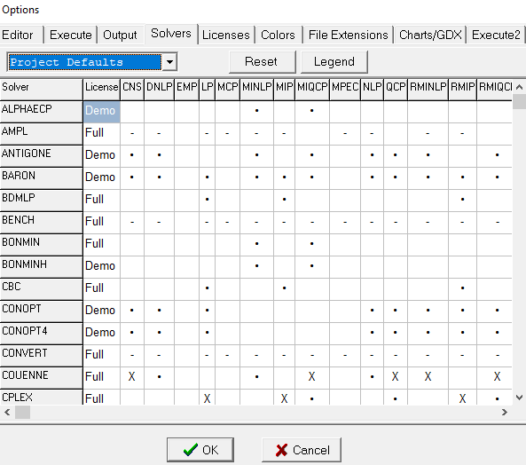
GAMS
GAMS provides different solvers to solve different types of optimal problem.
[6] An Introduction to GAMS [online]: https://www.gams.com/products/introduction/

Slide 24
GAMS
One example is given here to show how to solve an OPF in GAMS:
Sets for variables and parameters
Parameter values
[6] An Introduction to GAMS [online]: https://www.gams.com/products/introduction/

Slide 25
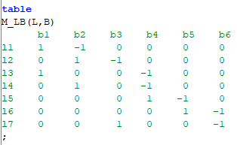
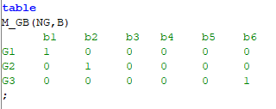
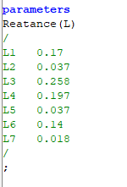
GAMS
One example is given here to show how to solve an OPF in GAMS:
Topology information
[6] An Introduction to GAMS [online]: https://www.gams.com/products/introduction/

Slide 26
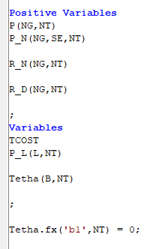
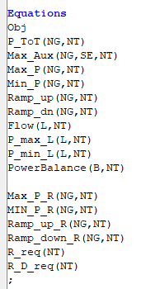
GAMS
One example is given here to show how to solve an OPF in GAMS:
Variables
Equations
[6] An Introduction to GAMS [online]: https://www.gams.com/products/introduction/

Slide 27
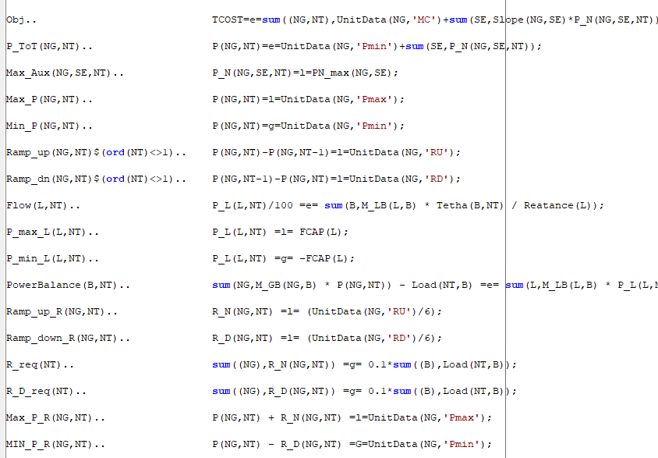
GAMS
One example is given here to show how to solve an OPF in GAMS:
[6] An Introduction to GAMS [online]: https://www.gams.com/products/introduction/

Slide 28
Interfacing GAMS and MATLAB
The optimization packages in MATLAB are useful for small-scale models.
When solving large-scale model, we can use MATLAB to handle parameter calculations and call GAMS to solve optimal problems.
This data exchange between GAMS and MATLAB is accomplished via the GDX (GAMS Data Exchange) file.
wgdx: write indexed parameters to GDX file
rgdx: read indexed parameters from GDX file
[6] An Introduction to GAMS [online]: https://www.gams.com/products/introduction/

Slide 29
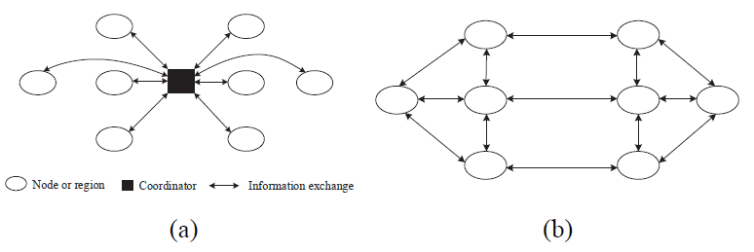
Distributed optimization
However, a centralized algorithm may not be effective any more for large-scale optimization problem.
To provide a scalable, fast solution to large scale optimization problems, distributed optimization algorithms are proposed [7]:
In a distributed framework, the original centralized problem is divided into a certain number of small-scale sub-problems.
Each sub-problem is solved by a single agent as a computation entity with agent-to-agent communication capabilities.
A certain communication between adjacent agents is required during the computation process to exchange necessary data according to a certain protocol.
Thus, all agents can solve the centralized problem collaboratively in a parallel fashion.
Fig.1 (a) Centralized algorithm; (b) Distributed algorithm [7]
[7] J. Liu, M. Benosman and A. U. Raghunathan, "Consensus-based distributed optimal power flow algorithm," 2015 IEEE Power & Energy Society Innovative Smart Grid Technologies Conference (ISGT), Washington, DC, 2015, pp. 1-5.

Slide 30
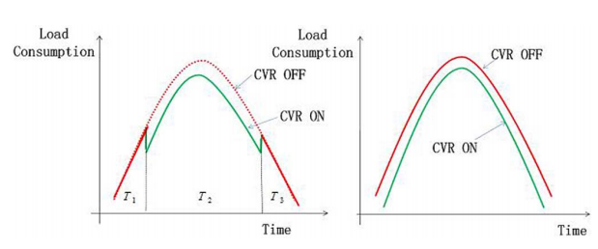
Distributed CVR in Unbalanced Distribution Systems with PV Penetration
Conservation voltage reduction (CVR) is an established idea and one of the most cost-effective way to save energy.
CVR can reduce voltages on the distribution system in a controlled manner for:
Short-term (peak-time) peak demand reduction
Long-term (24 hours) energy saving
CVR still keeps the lowest customer utilization voltage consistent with levels determined by regulatory agencies and standards-setting organizations
Fig.2 (left) Peak demand reduction and (right) 24-hr energy saving [8]
30
30
[8] Z. Wang and J. Wang, "Review on Implementation and Assessment of Conservation Voltage Reduction," in IEEE Transactions on Power Systems, vol. 29, no. 3, pp. 1306-1315, May 2014.

Slide 31
Distributed CVR in Unbalanced Distribution Systems with PV Penetration
To achieve CVR:
Conventional approach for implementing CVR is by adjusting tap positions of On-load Tap Changer (OLTC) at the substation transformers, which ensures the nodal voltages are reduced in a manner that neither violates the acceptable voltage ranges nor affects for performance.
A more advanced way of implementation is to integrate CVR into Volt/VAR optimization (OPF-based VVO) models as an objection function, which provide a framework for optimal control of voltage regulation and VAR control devices to achieve specific operational goals without violating any of the operational constraints.
31
31
[9] Q. Zhang, K. Dehghanpour and Z. Wang, "Distributed CVR in Unbalanced Distribution Systems With PV Penetration," in IEEE Transactions on Smart Grid, vol. 10, no. 5, pp. 5308-5319, Sept. 2019.

Slide 32
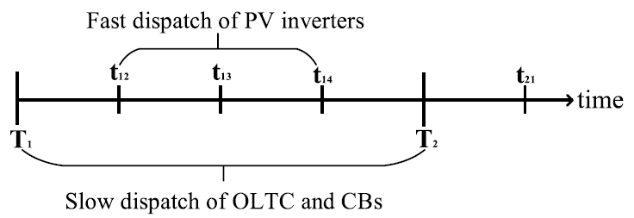
Distributed CVR in Unbalanced Distribution Systems with PV Penetration
In [9], a distributed multi-objective optimization model is proposed for implementing CVR in unbalanced three-phase distribution systems.
Fig.3 Multi-timescale voltage regulation framework in VVO
An optimization model is developed to coordinate the fast dispatch of PV inverters with the slow-dispatch of OLTC and CBs, in order to facilitate voltage reduction in unbalanced three-phase distribution systems.
In order to ensure the solution optimality and maintain customer data privacy and ownership, a distributed solution methodology is proposed to dispatch all the abovementioned devices in a unified optimization framework. The solution methodology is based on a modified ADMM technique to handle the non-convex optimization problem with discrete switching and tap changing variables.
The trade-off between voltage reduction and real power loss reduction is quantified numerically using the developed multi-objective VVO formulation.
32
32
[9] Q. Zhang, K. Dehghanpour and Z. Wang, "Distributed CVR in Unbalanced Distribution Systems With PV Penetration," in IEEE Transactions on Smart Grid, vol. 10, no. 5, pp. 5308-5319, Sept. 2019.

Slide 33
Multi-objective Optimization Model
A centralized optimization model is presented to coordinate the fast-dispatch of PV inverters and the slow-dispatch of conventional voltage regulation devices (OLTC and CBs) to facilitate voltage reduction in unbalanced distribution systems.
$$\min_{V_{i},P_{i},Q_{i}}\left(w_{1}\sum_{i=1}^{N}{\left(V_{i,φ}^{∗}\right)}+w_{2}\sum_{i=1}^{N}{\left({loss}_{i,φ}\right)}\right)$$
Multi-objective function aims to (1) minimize the largest bus voltage; (2) minimize active power losses, with the weight factors $w_{1}$ and $w_{2}$.
The distribution system operators can adjust the weighting factors $w_{1}$ and $w_{2}$ according to specific operational requirements.
s.t.
$$V_{i,φ}^{∗}≥\max_{t∈T}\left(V_{i,t,φ}\right)$$
Find the largest voltage magnitude at bus i at time t.
$${loss}_{i,φ}=\sum_{t=1}^{T}{\left(r_{i,φ}\frac{{\left(P_{i,t,φ}^{l}\right)}^{2}+{\left(Q_{i,t,φ}^{l}\right)}^{2}}{V_{s}^{2}}\right)}$$
Determines the overall active power losses on the line connecting bus i and bus i-1 at t.
33
33
[9] Q. Zhang, K. Dehghanpour and Z. Wang, "Distributed CVR in Unbalanced Distribution Systems With PV Penetration," in IEEE Transactions on Smart Grid, vol. 10, no. 5, pp. 5308-5319, Sept. 2019.

Slide 34
Multi-objective Optimization Model
$$P_{i,t,φ}^{l}=P_{i−1,t,φ}^{l}−P_{i,t,φ}^{ZIP}+P_{i,t,φ}^{pred}$$
Nodal active power balance formulation, which includes the active power in-flow and out-flow at bus i, active power output of PV inverter, as well as the ZIP active load of bus i.
$$P_{i,t,φ}^{PV}=P_{i,t,φ}^{pred}−ε_{i,t,φ}$$
The uncertainty of PV power is represented by Gaussian random variables for PV power prediction error. Accordingly, each agent predicts the available nodal PV power over the decision window. Due to the uncertainty of PV power in real-time, the predicted value $P_{i,t,φ}^{pred}$ is different from the actual PV power $P_{i,t,φ}^{PV}$. The difference is modeled using a Gaussian error variable $ε_{i,t,φ}$.
$$Q_{i,t,φ}^{l}=Q_{i−1,t,φ}^{l}−Q_{i,t,φ}^{ZIP}+Q_{i,t,φ}^{PV}+Q_{i,t}^{CB}$$
Nodal reactive power balance formulation, which determines the reactive power output of PV inverter at bus i and reactive power output of CB at bus i.
$$−q_{i,t,φ}^{∗}≤Q_{i,t,φ}^{PV}≤q_{i,t,φ}^{∗}$$
$$q_{i,t,φ}^{∗}=\sqrt{{\left(S_{i,t,φ}^{PV}\right)}^{2}−{\left(P_{i,t,φ}^{pred}\right)}^{2}}$$
Limit the reactive power capacity of PV inverters based on PV generation capacity and the active power output.
Obtains the CB reactive power injection at bus i. $I_{i,t}^{CB}$represents the on/off status of the CB at bus i during the dispatch period T. For buses without CB, $q_{i}^{CB}$ is set to zero.
$$Q_{i,t,φ}^{CB}=I_{i,t}^{CB}q_{i}^{CB}$$
34
34
[9] Q. Zhang, K. Dehghanpour and Z. Wang, "Distributed CVR in Unbalanced Distribution Systems With PV Penetration," in IEEE Transactions on Smart Grid, vol. 10, no. 5, pp. 5308-5319, Sept. 2019.

Slide 35
Multi-objective Optimization Model
$$P_{i,t,φ}^{ZIP}=P_{i,t,φ}^{D}(Z_{i}^{p}V_{i,t,φ}^{2}+I_{i}^{p}V_{i,t,φ}+P_{i}^{p})$$
The ZIP active and reactive load by second-order polynomial formulations. Summation of ZIP coefficients for both active and reactive are set to 1. $P_{i,t,φ}^{D}$ and $Q_{i,t,φ}^{D}$ are active and reactive power demand factors during the dispatch period, respectively.
$$Q_{i,t,φ}^{ZIP}=Q_{i,t,φ}^{D}(Z_{i}^{q}V_{i,t,φ}^{2}+I_{i}^{q}V_{i,t,φ}+P_{i}^{q})$$
$$V_{i,t,φ}=V_{i,t,φ}−\frac{r_{i−1,t,φ}P_{i−1,t,φ}^{l}+x_{i−1,t,φ}Q_{i−1,t,φ}^{l}}{V_{s}}$$
Bus voltage using DistFlow equations
$$V_{1,t}=V_{s}+I_{t}^{tap}V^{tap}$$
The substation transformer secondary voltage $V_{1,t}$ according to primary voltage $V_{s}$ and OLTC tap position $I_{t}^{tap}$.
$${V_{i,t}^{min}≤V}_{i,t,φ}≤V_{i,t}^{max}$$
The bus voltage is maintained within the allowable range, and the voltage limits are set to be [0.95, 1.05].
35
35
[9] Q. Zhang, K. Dehghanpour and Z. Wang, "Distributed CVR in Unbalanced Distribution Systems With PV Penetration," in IEEE Transactions on Smart Grid, vol. 10, no. 5, pp. 5308-5319, Sept. 2019.

Slide 36
Multi-objective Optimization Model
$$\sum_{t∈T}{\left|I_{i,t}^{CB}−I_{i−1,t}^{CB}\right|≤{CB}^{max}},I_{i,t}^{CB}∈\{0,1\}$$
$$\sum_{t∈T}{\left|I_{t}^{tap}−I_{t−1}^{tap}\right|≤{TAP}^{max}}$$
The maximum allowable switching actions of CBs and OLTC during the dispatch period. For example, in the following case studies, the ${CB}^{max}$ is set to be 3 and ${TAP}^{max}$ is set to be 5.
$$I_{t}^{tap}∈\{−10,−9,…,0,…9,10\}$$
36
36
[9] Q. Zhang, K. Dehghanpour and Z. Wang, "Distributed CVR in Unbalanced Distribution Systems With PV Penetration," in IEEE Transactions on Smart Grid, vol. 10, no. 5, pp. 5308-5319, Sept. 2019.

Slide 37
Distributed Algorithm
A distributed algorithm based on Alternating Direction Method of Multipliers (ADMM) is an algorithm that solves convex optimization problems by breaking them into smaller pieces, each of which are then easier to handle. It has recently found wide application in a number of areas [10].
With ADMM, the complexity of the OPF problem scales with the sub-area size rather than with the full network size.
ADMM iteratively minimizes the augmented Lagrangian over three types of variable:
The primary variables.
The auxiliary variables, which are used to enforce boundary conditions among neighboring area (exchanged information).
The Lagrangian multipliers for the relaxed problem (exchanged information).
However, the ADMM is originally developed to solve convex problem in the distributed manner, so that modifications to ADMM are necessary to correctly and efficiently handle the discrete variables.
[10] Boyd, Stephen, et al. "Distributed optimization and statistical learning via the alternating direction method of multipliers." Foundations and Trends in Machine learning, 3.1 1-122, 2011.

Slide 38
Modified ADMM
In the proposed method, discrete variables are not only relaxed by continues variables, but also guaranteed as a generalized part of the objective function in the iterative process of the modified ADMM [11].
(1) Original problem
$$\min_{x,I}{f(x,I)}$$
s.t.
$$I=y$$
Discrete variable $I$ is replaced with an auxiliary continuous variable $y$.
An additional auxiliary equality $z$is introduced.
$$z=g(x,y)$$
$$I∈ℤ,x,y∈ℝ$$
(2) Augmented Lagrangian function
$$ℒ_{p}=f\left(x_{i},y_{i}\right)+λ_{i}^{z}\left(z_{i}−g(x_{i},I_{i})\right)+\frac{ρ}{2}{\left\|z_{i}−g(x_{i},I_{i})\right\|}_{2}^{2}$$
(3) Iterative update rules (with the iteration number denoted by k)
$$\left(x_{i}\left(k+1\right),y_{i}(k+1)\right)=arg\min_{x,y}{ℒ_{p}}$$
$$I_{i}\left(k+1\right)=arg\min_{I}{{\left\|z_{i}(k+1)−g(x_{i}(k+1),I_{i})\right\|}_{2}^{2}}$$
$$λ_{i}^{z}\left(k+1\right)=λ_{i}^{z}\left(k\right)+ρ\left(z_{i}(k+1)−g(x_{i}(k+1),I_{i}(k+1))\right)$$
38
38
38
38
[11] Q. Liu, X. Shen and Y. Gu, "Linearized ADMM for Nonconvex Non-smooth Optimization With Convergence Analysis," in IEEE Access, vol. 7, pp. 76131-76144, 2019.
38

Slide 39
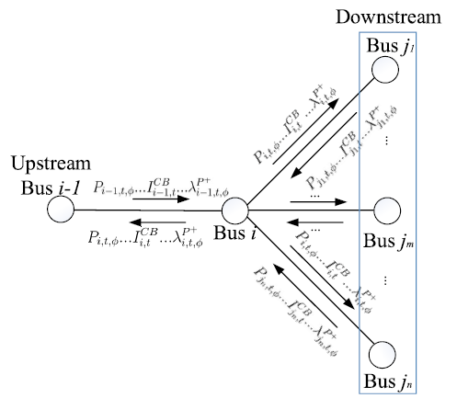
Iterative Process of ADMM
In the iterative process of ADMM:
Step.1 For each bus agent i at iteration k, local optimization problems are solved independently and in parallel. Solutions to bus local variables $X_{i}$ and $Y_{i}$ are obtained.
$$\left(X_{i}\left(k+1\right),Y_{i}(k+1)\right)=arg\min_{X,Y}{ℒ_{p}\left(X_{i},Y_{i},λ_{i}(k)\right)}$$
Fig.4 Local optimization solution exchange between control agents at different buses [9]
39
39
[9] Q. Zhang, K. Dehghanpour and Z. Wang, "Distributed CVR in Unbalanced Distribution Systems With PV Penetration," in IEEE Transactions on Smart Grid, vol. 10, no. 5, pp. 5308-5319, Sept. 2019.

Slide 40
Iterative Process of ADMM
Step.2 For each bus agent i at iteration k, local optimization solution exchanges take place between neighboring agents to update variables based on respective bus local variables and variables at buses connected to bus i, which are obtained from Step 1.
Hence, variable set $X_{i}$ is updated by averaging the respective local bus variables, where $n_{i}$ denotes the number of buses connected to bus i + 1:
$$P_{i,t,φ}^{l}(k+1)=\frac{1}{2}\left(P_{i,t,φ}^{+}\left(k+1\right)+P_{i,t,φ}^{−}(k+1)\right)$$
$$Q_{i,t,φ}^{l}(k+1)=\frac{1}{2}\left(Q_{i,t,φ}^{+}\left(k+1\right)+Q_{i,t,φ}^{−}(k+1)\right)$$
$$U_{i,t,φ}(k+1)=\frac{1}{n_{i}}\left(U_{i,t,φ}^{+}\left(k+1\right)+…+U_{i,t,φ}^{−}(k+1)\right)$$
Variables $I_{i,t}^{CB}$ and $I_{t}^{tap}$ are updated by solving local bus optimization problem using $X_{i}\left(k+1\right)$ and $Y_{i}\left(k+1\right)$:
$$I_{i,t}^{CB}(k+1)=arg\min_{I_{i,t}^{CB}}\left\|z_{1, i}\left(k+1\right)−g_{1}(X_{i}\left(k+1\right),I_{i,t}^{CB})\right\|$$
$$I_{t}^{tap}(k+1)=arg\min_{I_{t}^{tap}}\left\|z_{2, i}\left(k+1\right)−g_{2}(X_{i}\left(k+1\right),I_{t}^{tap})\right\|$$
40
40
[9] Q. Zhang, K. Dehghanpour and Z. Wang, "Distributed CVR in Unbalanced Distribution Systems With PV Penetration," in IEEE Transactions on Smart Grid, vol. 10, no. 5, pp. 5308-5319, Sept. 2019.

Slide 41
Iterative Process of ADMM
Step.3 For each bus i at iteration k, the Lagrange multipliers are updated based on the ADMM iterative rules and the variables obtained in previous steps. Hence, the Lagrange multipliers for variable set $X_{i}$ are updated using
$$λ_{i,t,φ}^{P^{+}}\left(k+1\right)=λ_{i,t,φ}^{P^{+}}\left(k\right)+ρ\left(P_{i,t,φ}^{+}\left(k+1\right)−P_{i,t,φ}^{l}(k+1)\right)$$
$$λ_{i,t,φ}^{U^{+}}\left(k+1\right)=λ_{i,t,φ}^{U^{+}}\left(k\right)+ρ\left(U_{i,t,φ}^{+}\left(k+1\right)−U_{i,t,φ}^{l}(k+1)\right)$$
$$λ_{i,t,φ}^{P^{−}}\left(k+1\right)=λ_{i,t,φ}^{P^{−}}\left(k\right)+ρ\left(P_{i,t,φ}^{−}\left(k+1\right)−P_{i,t,φ}^{l}(k+1)\right)$$
$$λ_{i,t,φ}^{U^{−}}\left(k+1\right)=λ_{i,t,φ}^{U^{−}}\left(k\right)+ρ\left(U_{i,t,φ}^{−}\left(k+1\right)−U_{i,t,φ}^{l}(k+1)\right)$$
$$λ_{i,t,φ}^{Q^{+}}\left(k+1\right)=λ_{i,t,φ}^{Q^{+}}\left(k\right)+ρ\left(Q_{i,t,φ}^{+}\left(k+1\right)−Q_{i,t,φ}^{l}(k+1)\right)$$
$$λ_{i,t,φ}^{Q^{−}}\left(k+1\right)=λ_{i,t,φ}^{Q^{−}}\left(k\right)+ρ\left(Q_{i,t,φ}^{−}\left(k+1\right)−Q_{i,t,φ}^{l}(k+1)\right)$$
Lagrange multipliers for auxiliary equality constraints corresponding to $Y_{i}$ and $I_{i}$ are updated using:
$$λ_{i,t}^{y^{CB}}\left(k+1\right)=λ_{i,t}^{y^{CB}}\left(k\right)+ρ\left(y_{i,t}^{CB}\left(k+1\right)−I_{i,t}^{CB}(k+1)\right)$$
$$λ_{t}^{y^{tap}}\left(k+1\right)=λ_{t}^{y^{tap}}\left(k\right)+ρ\left(y_{t}^{tap}\left(k+1\right)−I_{t}^{tap}(k+1)\right)$$
Lagrange multipliers for auxiliary equality constraints $g_{1}(∙)$ and $g_{2}(∙)$ are updated using:
$$λ_{i}^{z_{1}}\left(k+1\right)=λ_{i}^{z_{1}}\left(k\right)+ρ\left(z_{1,i}\left(k+1\right)−g_{1}(X_{i}\left(k+1\right),I_{i,t}^{CB}(k+1))\right)$$
$$λ_{i}^{z_{2}}\left(k+1\right)=λ_{i}^{z_{2}}\left(k\right)+ρ\left(z_{2,i}\left(k+1\right)−g_{2}(X_{i}\left(k+1\right),I_{t}^{tap}(k+1))\right)$$
41
41
[9] Q. Zhang, K. Dehghanpour and Z. Wang, "Distributed CVR in Unbalanced Distribution Systems With PV Penetration," in IEEE Transactions on Smart Grid, vol. 10, no. 5, pp. 5308-5319, Sept. 2019.

Slide 42
Iterative Process of ADMM
Step.4 Increase k by 1 till it reaches the maximum iteration number.
Case Study
In this case study, the convergence analysis and simulation results of our proposed method are presented.
First, we present the convergence analysis to show the impact of different penalty parameter ρ on convergence speed.
We then demonstrate the effectiveness of our proposed method through numerical evaluations on three IEEE standard benchmarks to study load/loss reduction through CVR implementation.
In all the simulations, the CVR functionality was tested over 3 hours of peak load period with 15-minute time steps.
42
42
[9] Q. Zhang, K. Dehghanpour and Z. Wang, "Distributed CVR in Unbalanced Distribution Systems With PV Penetration," in IEEE Transactions on Smart Grid, vol. 10, no. 5, pp. 5308-5319, Sept. 2019.

Slide 43
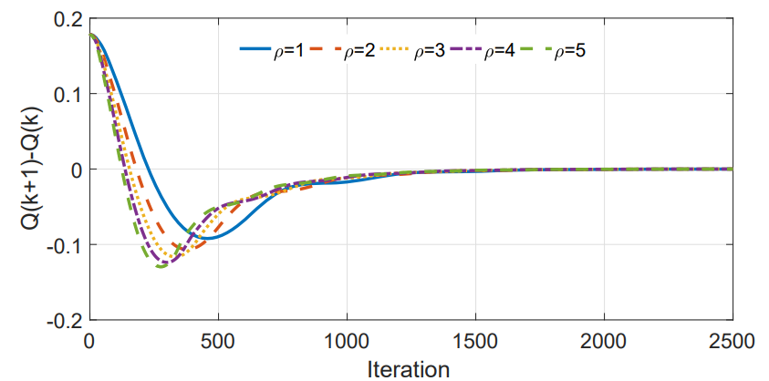
Algorithm Convergence: IEEE 13-bus System
In order to perform convergence studies, the proposed method is implemented on IEEE 13-bus system and the results are recorded at each iteration.
Within certain range of $ρ$, the proposed algorithm can converge faster with larger values.
However, increasing to a too large value will cause numerical instability and divergence.
Fig.5 Convergence of the distributed optimization: Impact of different penalty parameter values [9]
43
43
[9] Q. Zhang, K. Dehghanpour and Z. Wang, "Distributed CVR in Unbalanced Distribution Systems With PV Penetration," in IEEE Transactions on Smart Grid, vol. 10, no. 5, pp. 5308-5319, Sept. 2019.

Slide 44
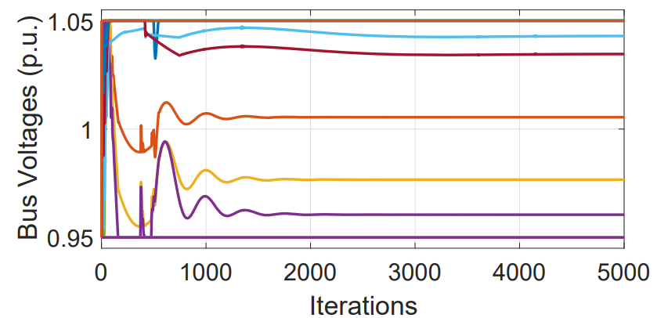
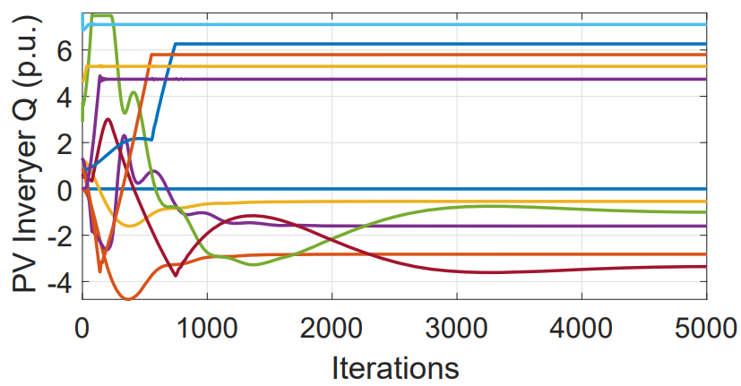
Algorithm Convergence: IEEE 13-bus System
All the optimal voltage magnitudes have converged to values within [0.95 p.u., 1.05 p.u.] interval, which satisfies the bus voltage limit constraints.
Most of variables converge after 3000 iterations, while only a few take more than 4000 iterations to converge.
Fig.6 Convergence of the distributed optimization: Iterative updates of bus voltage magnitudes $ρ=5$ [9]
Fig.7 Convergence of the distributed optimization: Iterative updates of PV inverter reactive power outputs $ρ=5$ [9]
44
44
[9] Q. Zhang, K. Dehghanpour and Z. Wang, "Distributed CVR in Unbalanced Distribution Systems With PV Penetration," in IEEE Transactions on Smart Grid, vol. 10, no. 5, pp. 5308-5319, Sept. 2019.

Slide 45
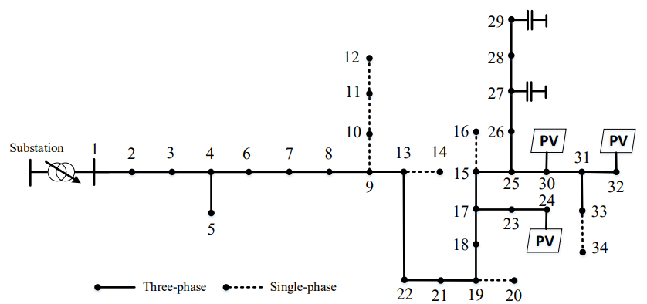
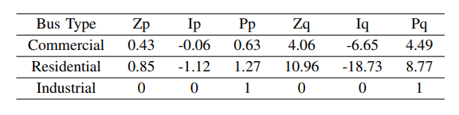
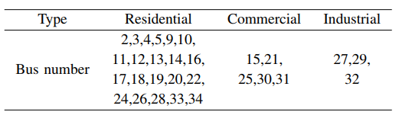
Numerical Results: IEEE 34-bus System
The results of simulation studies on modified IEEE 34-bus distribution system (Fig. 7) are presented in this section.
The substation OLTC is within ±10% tap range.
Two three-phase CBs are installed at buses 27 and 29, and the CB capacities are the same as the original system.
The PV generations are aggregated at buses 24, 30 and 32.
Table I ZIP Coefficients for each customer type [9]
Table II Bus Type [9]
Fig.8 Case II: Modified IEEE 34-bus test distribution system [9]
45
45
[9] Q. Zhang, K. Dehghanpour and Z. Wang, "Distributed CVR in Unbalanced Distribution Systems With PV Penetration," in IEEE Transactions on Smart Grid, vol. 10, no. 5, pp. 5308-5319, Sept. 2019.

Slide 46
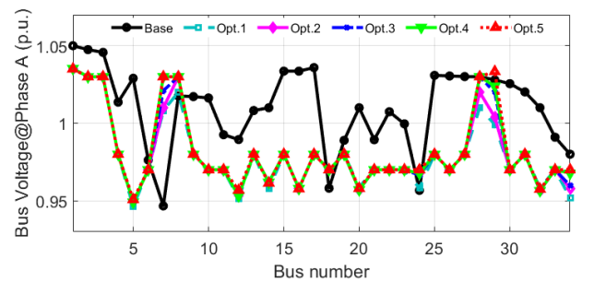
Numerical Results: IEEE 34-bus System
For comparison, a base case without any VVO is defined, where unity-power factor control mode is used for PVs, the tap position of OLTC is fixed, and CB status is on.
The optimal voltage magnitudes of Opt. 1 to Opt. 5 are generally lower than the base case (black solid line), which shows the voltage reduction effects of VVO.
Due to the optimization constraints and the impacts of reactive power injection from PV inverters and CBs, the optimal voltage magnitude on a number of buses are slightly higher than the base case.
Opt. 1 shows the lowest bus voltage, which demonstrates the CVR impact on voltage reduction, as a higher weight is assigned to voltage minimization component.
Fig.9 Voltage profiles at t=1 and for $φ_{A}$ of base case and cases Opt.1 to Opt. 5 [9]
* Different weight factors: Opt.1, Opt.2, Opt.3, Opt.4 and Opt.5, $\left(w_{1},w_{2}\right)$ change from $\left(1,0\right)$ to $\left(0,1\right)$
46
46
[9] Q. Zhang, K. Dehghanpour and Z. Wang, "Distributed CVR in Unbalanced Distribution Systems With PV Penetration," in IEEE Transactions on Smart Grid, vol. 10, no. 5, pp. 5308-5319, Sept. 2019.

Slide 47
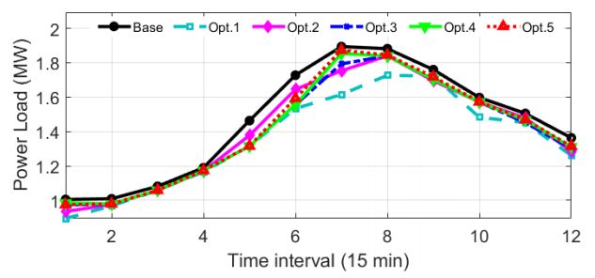
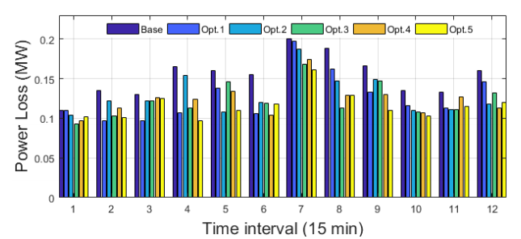
Numerical Results: IEEE 34-bus System
Among the cases Opt.1 to Opt.5 and the base case, Opt.1 has the largest load reduction and Opt.5 has the largest loss reduction, which shows the effect of various $w_{1}$ and $w_{2}$, respectively.
Hence, it is corroborated that by changing the weight factors in the optimization model the trade-off between CVR and loss minimization in the final decision solution can be controlled effectively.
Fig.10 Load power consumption for the base case and cases Opt.1 to Opt. 5 [9]
Fig.11 Power losses for the base case and cases Opt.1 to Opt. 5 [9]
* Different weight factors: Opt.1, Opt.2, Opt.3, Opt.4 and Opt.5, $\left(w_{1},w_{2}\right)$ change from $\left(1,0\right)$ to $\left(0,1\right)$
47
47
[9] Q. Zhang, K. Dehghanpour and Z. Wang, "Distributed CVR in Unbalanced Distribution Systems With PV Penetration," in IEEE Transactions on Smart Grid, vol. 10, no. 5, pp. 5308-5319, Sept. 2019.

Slide 48
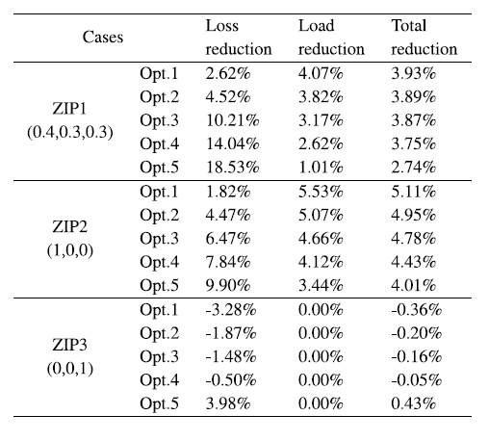
Numerical Results: IEEE 34-bus System
For ZIP1 and ZIP2, loss reduction levels are increasing from Opt. 5 to Opt. 1, however, the load reduction and total energy reduction decrease at the same time.
For voltage-dependent loads, ZIP1 and ZIP2, load reduction (due to voltage reduction) accounts for the majority of the change in total energy savings.
On the other hand, since CVR has no impact on the constant power loads, ZIP3, for that case load reduction is zero and the loss optimization is the only effective method to reduce the peak demand.
Table III Summary of system loss, load and total energy reduction with different ZIP coefficients and weight factor (IEEE 34-bus system) [9]
* Different weight factors: Opt.1, Opt.2, Opt.3, Opt.4 and Opt.5, $\left(w_{1},w_{2}\right)$ change from $\left(1,0\right)$ to $\left(0,1\right)$
48
48
[9] Q. Zhang, K. Dehghanpour and Z. Wang, "Distributed CVR in Unbalanced Distribution Systems With PV Penetration," in IEEE Transactions on Smart Grid, vol. 10, no. 5, pp. 5308-5319, Sept. 2019.

Slide 49
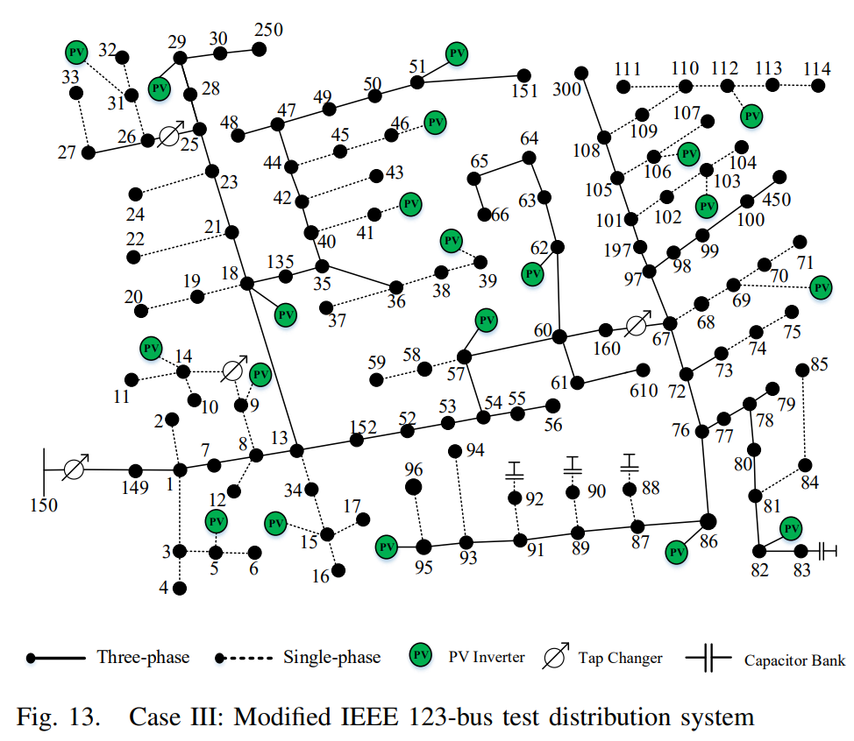
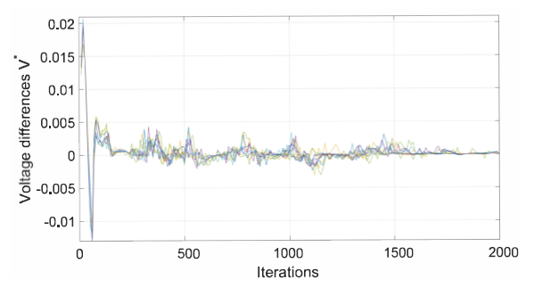
Numerical Results: IEEE 123-bus System
To test our proposed distributed algorithm on a larger system, simulation results for modified IEEE 123-bus distribution system with a higher number of PV inverters, CVs and OLTCs are shown.
Fig.13 Convergence of the distributed optimization: bus voltage residues at each iteration [9]
Voltage residues $V^{∗}$ converge to zero as the iteration number, k, increases.
The algorithm converges to optimal solution within an acceptable number of iterations in a reasonable time.
Fig.12 Modified IEEE 123-bus test distribution system [9]
49
49
[9] Q. Zhang, K. Dehghanpour and Z. Wang, "Distributed CVR in Unbalanced Distribution Systems With PV Penetration," in IEEE Transactions on Smart Grid, vol. 10, no. 5, pp. 5308-5319, Sept. 2019.

Slide 50
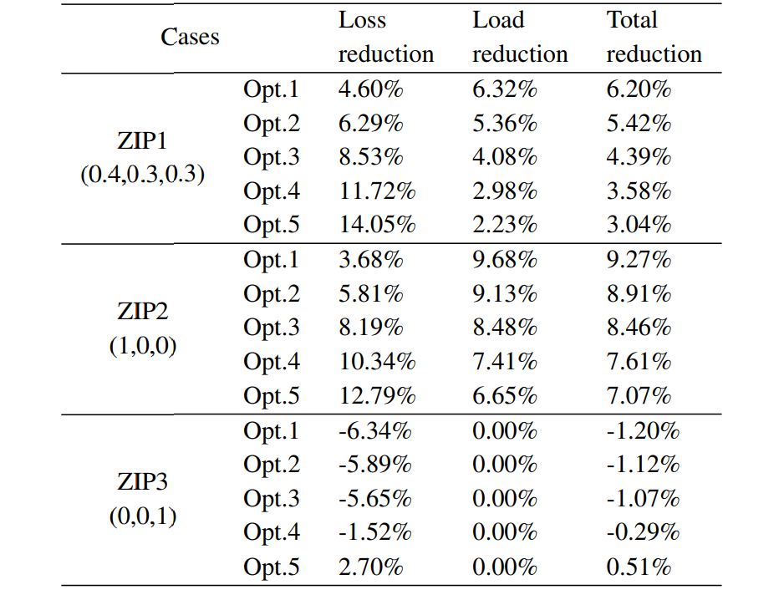
Numerical Results: IEEE 123-bus System
Table IV Summary of system loss, load and total energy reduction with different ZIP coefficients and weight factor (IEEE 123-bus system) [9]
The conclusions drawn in Table. III regarding the tradeoff between voltage magnitude optimization and network loss reduction under different ZIP characteristics are again verified for the larger IEEE 123-bus test system
* Different ZIP factors: ZIP1, ZIP2 and ZIP3
* Different weight factors: Opt.1, Opt.2, Opt.3, Opt.4 and Opt.5
50
50
[9] Q. Zhang, K. Dehghanpour and Z. Wang, "Distributed CVR in Unbalanced Distribution Systems With PV Penetration," in IEEE Transactions on Smart Grid, vol. 10, no. 5, pp. 5308-5319, Sept. 2019.

Slide 51
Heuristic methods
In some cases, conventional optimization and distributed optimization methods are developed with some theoretical assumptions, such as convexity, differentiability and continuity, which may not be suitable for the actual OPF [12].
Therefore, heuristic methods have been widely used for solving OPF due to their properties like robustness, flexibility and converging global optimum (near global optimum).
Genetic algorithm
GA creates a new population using gene of individuals belong to previous population. The individuals which have the best fitness degree are selected and new individuals are generated.
Particle swarm optimization
Food searching of birds in the space is similar to searching solution for a problem. Each individual solution is called a particle in searching space; it corresponds to a bird in the swarm.
[12] M. Niu, C. Wan and Z. Xu, “A review on applications of heuristic optimization algorithms for optimal power flow in modern power systems”, in Journal of Modern Power systems and Clean Energy, volume 2, issue 4, pp 289-297, Dec. 2014.

Slide 52
Heuristic methods
Advantages:
It will always give you a not so bad solution.
It is a derivative-free technique.
It is less sensitivity to the nature of the objective function compared to the conventional mathematical approaches.
Disadvantages:
It lacks somewhat a solid mathematical foundation for analysis to be overcome in the future development of relevant theories.
It requires relatively a longer computation time than conventional optimization methods.
The dependency on initial point and parameters
Difficulty in finding optimal design parameters
Stochastic characteristic of the final outputs
[13] K. Y. Lee and J. Park, "Application of Particle Swarm Optimization to Economic Dispatch Problem: Advantages and Disadvantages," 2006 IEEE PES Power Systems Conference and Exposition, Atlanta, GA, 2006, pp. 188-192.

Slide 53
References
[1] Carpentier, J. "Contribution a l’etude du dispatching economique." Bulletin de la Societe Francaise des Electriciens3.1 (1962): 431-447.
[2] Abdi, Hamdi, Soheil Derafshi Beigvand, and Massimo La Scala. "A review of optimal power flow studies applied to smart grids and microgrids." Renewable and Sustainable Energy Reviews 71 (2017): 742-766.
[3] Gan, Lingwen, et al. "Optimal power flow in tree networks." 52nd IEEE Conference on Decision and Control. IEEE, 2013.
[4] Bai, Xiaoqing, et al. "Semidefinite programming for optimal power flow problems." International Journal of Electrical Power & Energy Systems 30.6-7 (2008): 383-392.
[5] Zhao, Changhong, Emiliano Dall’Anese, and Steven H. Low. "Convex relaxation of OPF in multiphase radial networks with delta connection." Proc. of Bulk Power Systems Dynamics and Control Symposium. 2017.
[6] An Introduction to GAMS [online]: https://www.gams.com/products/introduction/
[7] J. Liu, M. Benosman and A. U. Raghunathan, "Consensus-based distributed optimal power flow algorithm," 2015 IEEE Power & Energy Society Innovative Smart Grid Technologies Conference (ISGT), Washington, DC, 2015, pp. 1-5.
[8] Z. Wang and J. Wang, "Review on implementation and assessment of conservation voltage reduction," in IEEE Transactions on Power Systems, vol. 29, no. 3, pp. 1306-1315, May 2014.
[9] Q. Zhang, K. Dehghanpour and Z. Wang, "Distributed CVR in unbalanced distribution systems with PV penetration," in IEEE Transactions on Smart Grid, vol. 10, no. 5, pp. 5308-5319, Sept. 2019.
[10] Boyd, Stephen, et al. "Distributed optimization and statistical learning via the alternating direction method of multipliers." Foundations and Trends in Machine learning, 3.1 1-122, 2011.
[11] Q. Liu, X. Shen and Y. Gu, "Linearized ADMM for nonconvex non-smooth optimization with convergence analysis," in IEEE Access, vol. 7, pp. 76131-76144, 2019.
[12] M. Niu, C. Wan and Z. Xu, “A review on applications of heuristic optimization algorithms for optimal power flow in modern power systems”, in Journal of Modern Power systems and Clean Energy, volume 2, issue 4, pp 289-297, Dec. 2014.
[13] K. Y. Lee and J. Park, "Application of particle swarm optimization to economic dispatch problem: advantages and disadvantages," 2006 IEEE PES Power Systems Conference and Exposition, Atlanta, GA, 2006, pp. 188-192.

Slide 54
Thank you!

